Slide 1
MDA Lab Result Elements Analysis Overview
Data Pattern and Trend Tendency Reports
Zijun Wu
Leukemia Department Visualization Reports
Nov 6, 2023

Slide 2
Agenda
Problem Statement
Data Profile
Data Processing
Data problems and difficulties & solutions
Feature engineering
Analytical Models
Proposed Solution and Model Selection
Model Performance Expectation for New Population Cohort
Model Comparison with Existing Solution
Health Care Impact - Real World
Solution Weaknesses and Future Improvement
Future Work (Other Models or Solutions)
2
Notes:
Of my presentation

Slide 3
Problem Statement
0.5%-1% cancer will become tMN patients, the longest latency could be 7 years.
Find out how to target these tMN patients before the
Therapy related leukemia progresses rapidly, and patients may face a life-threatening situation within a month.
Devise a time-efficient prediction model capable of delivering predictive outcomes prior to diagnosis
tMN prediction is a race of time
tMN Is a race of time to predict the acute disease before
As the potential patients approaching to the critical transition point, more signs are showing on their body, but they becoming more and more vulnable to the transition to tMNs.
The primary objective of analyzing this dataset is to understand the hematological profiles of patients, particularly in relation to the diagnosis of tMN.
This involves exploring trends, patterns, and potential indicators within the hematological parameters leading up to the diagnosis date.
The lab data provides a high-level overview of the data, including patient information, hematological parameters, and temporal aspects, setting the stage for further exploration and analysis.
Notes:
the onset of therapy-related leukemia in potential tMN patients.
A race of time

Slide 4
Data Profile
The dataset comprises 48,732,425 records capturing diverse hematological parameters across numerous patient encounters.
Each record provides insight into a patient's health status based on hematological measurements during a specific encounter.
Time-based information allows for the exploration of how hematological parameters relate to the diagnosis date and the time intervals leading up to the diagnosis.
Data Dimension | Descriptions
Data Variables | from 97,000 cancer patients, including 217 tMN patients
Data Size | 5 million records after cleaning duplicates
Data Type | Time-based numerical data, categorical data
Data Context | MD Anderson lab data
Notes:
Data introduction

Slide 5
Pre-Data Processing
Data Problems:
1. No CHIP category, filtering out using indicators or other features
2. Don’t have much before and after chemotherapy indicator differences or comparison (lack of relevant key features)
3. Dates of each leukemia treatment
Multi-layer filtering to get tMN patients.
No classification of tMN patients. Filtering out based on conditional filtering on 514600 diagnosis records.
Get 217 out of
Create relevant key features

Slide 6
Limited Temporal Data:
Rapidly progressing diseases often have a short timeframe between diagnosis and critical events (e.g., death). This results in a limited amount of temporal data available for model training, making it challenging to capture the dynamics of disease progression adequately.
Imbalanced Data:
The dataset may be imbalanced, with a small number of instances representing the critical events (e.g., death) compared to non-critical events. This imbalance can affect model performance, as the algorithm may be biased towards predicting the majority class.
Dynamic Nature of the Disease:
Rapidly progressing diseases can exhibit dynamic and unpredictable patterns, making it difficult to model and predict the disease trajectory accurately. Changes in patient condition may occur rapidly, and capturing these nuances in the data is challenging.
Limited Feature Stability:
Features that are relevant early in the disease progression might lose their significance as the disease advances. Identifying stable features that provide consistent predictive power throughout the progression becomes a challenge.

Slide 7
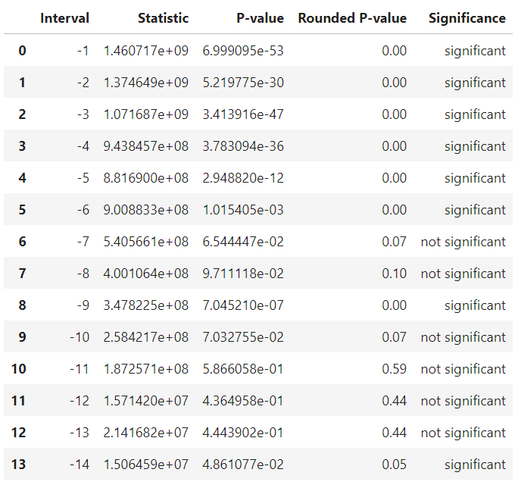
WBC

Slide 8
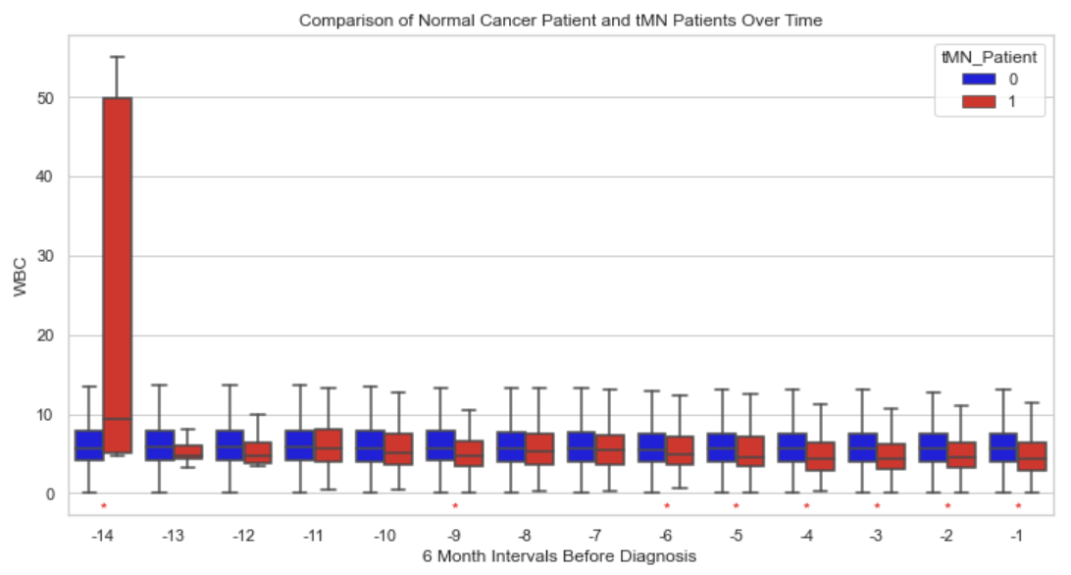
WBC
8

Slide 9
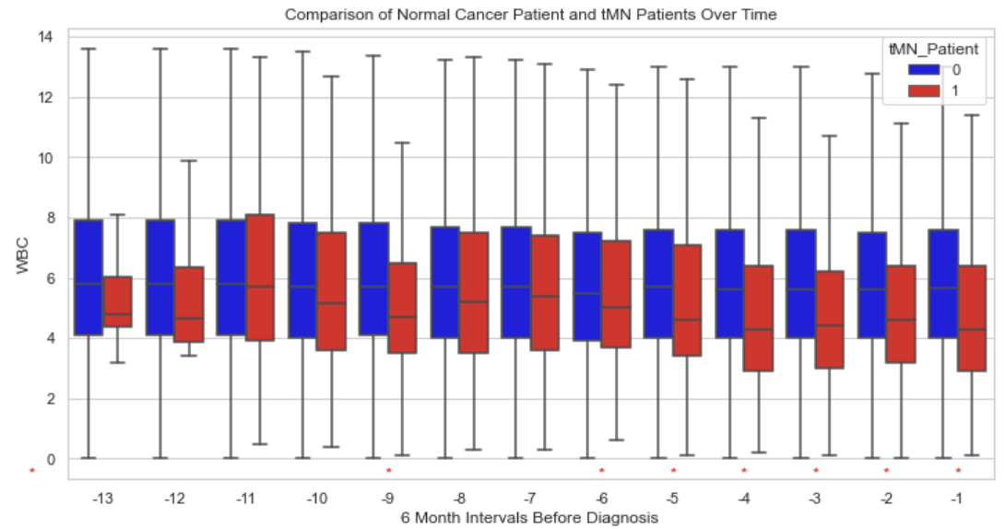
WBC
tMN patients:
WBC level is lower and consistently decreasing dated back to 3 years ago.
Highly skewed in the -14 time interval, 7 years ago
For time interval -14, significant but in the wrong direction

Slide 10
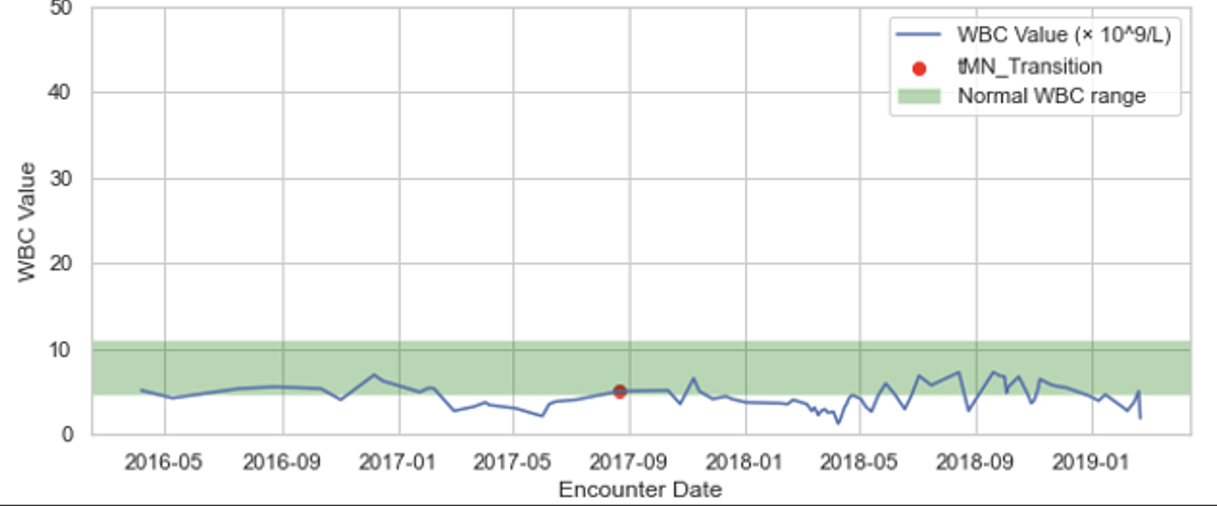
WBC – Individual Graphs
All graph titles and identifiers have been removed to protect patient privacy
10

Slide 11
WBC Individual Graphs – All Patients
GIF deleted for patient privacy protection

Slide 12
WBC Individual Graphs – All Patients
GIF deleted for patient privacy protection

Slide 13
WBC Individual Graphs – All Patients
GIF deleted for patient privacy protection

Slide 14
WBC Individual Graphs – All Patients
GIF deleted for patient privacy protection

Slide 15
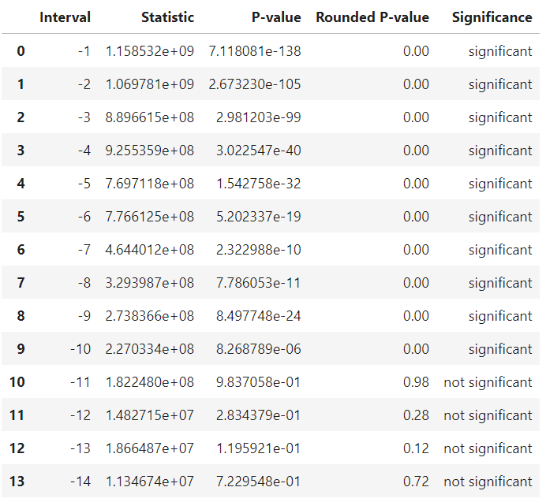
RBC

Slide 16
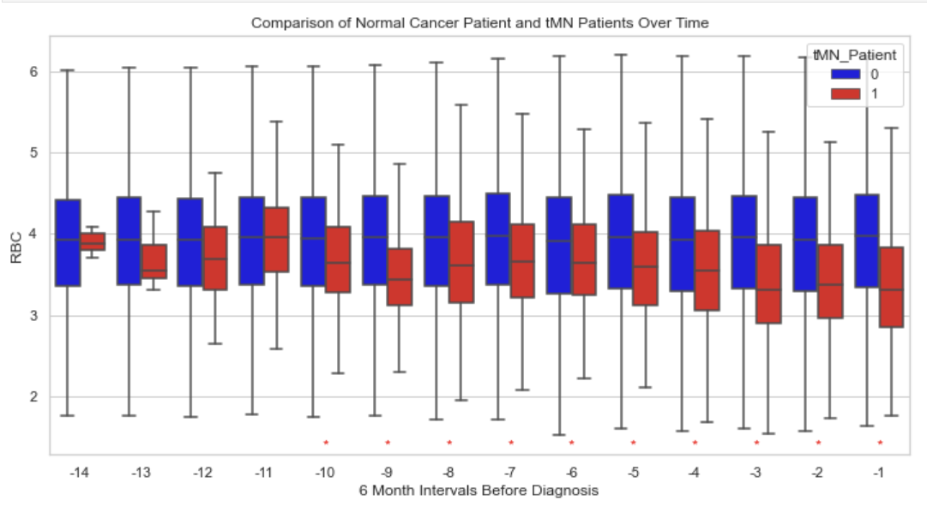
RBC – General Trend*
tMN patients:
RBC level is lower and consistently decreasing dated back to 5 years ago
Comparatively strong indicators

Slide 17
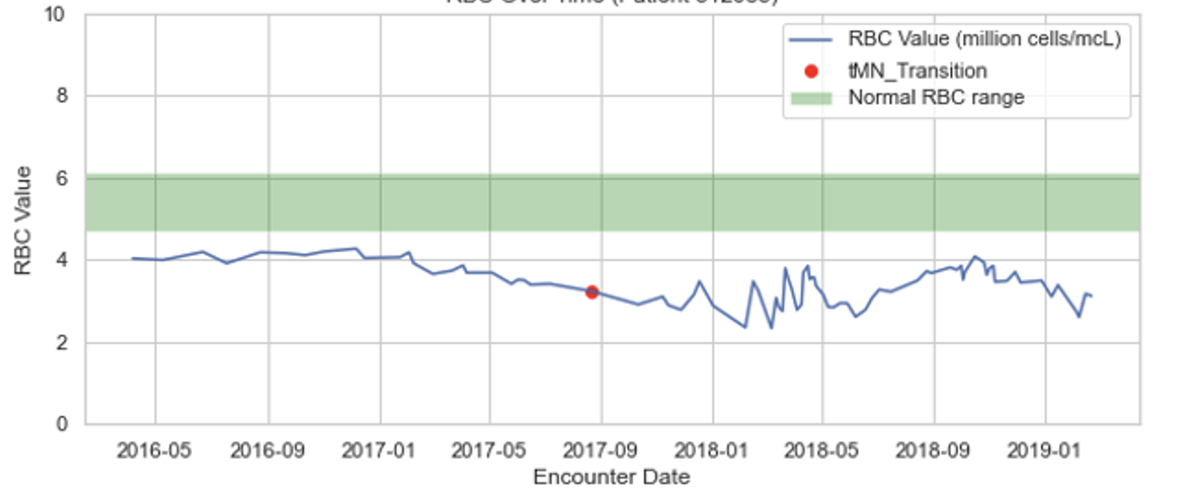
RBC – Individual Graphs
All graph titles and identifiers have been removed to protect patient privacy
17

Slide 18
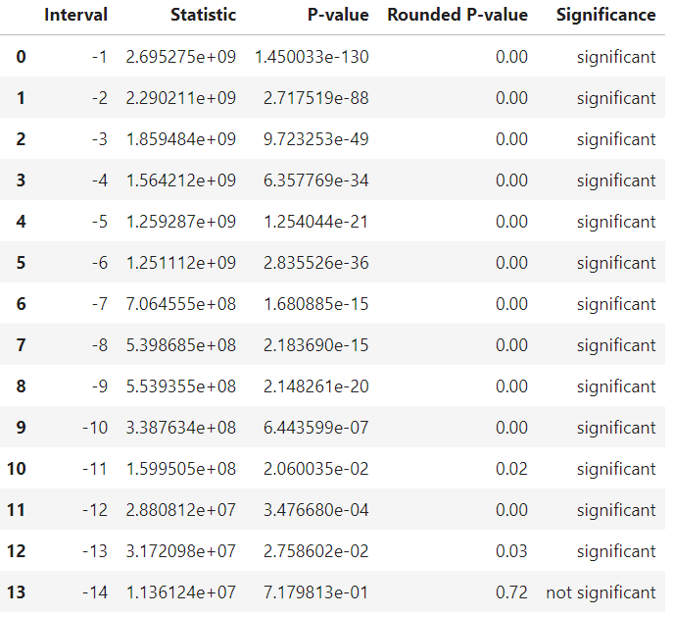
MCV

Slide 19
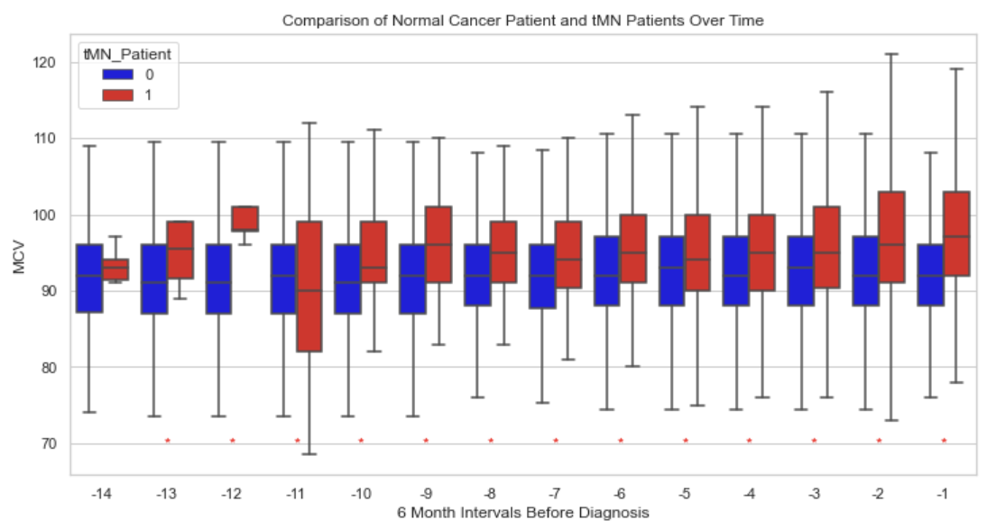
MCV – General Trend
tMN patients:
MCV level is higher and consistently increasing dated back to 5 years ago
Fluctuate at interval -11
Outliers affect the group -11

Slide 20
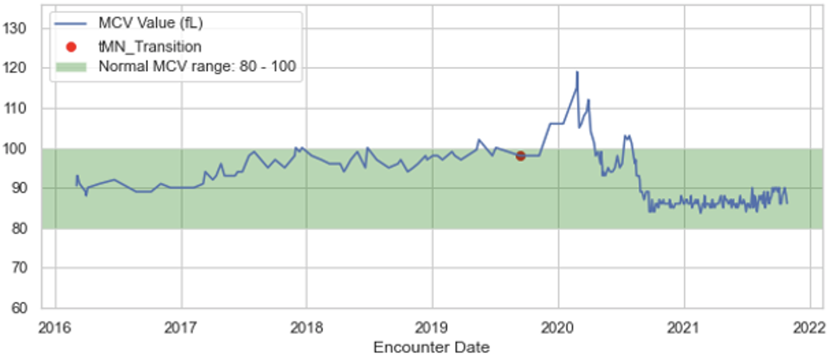
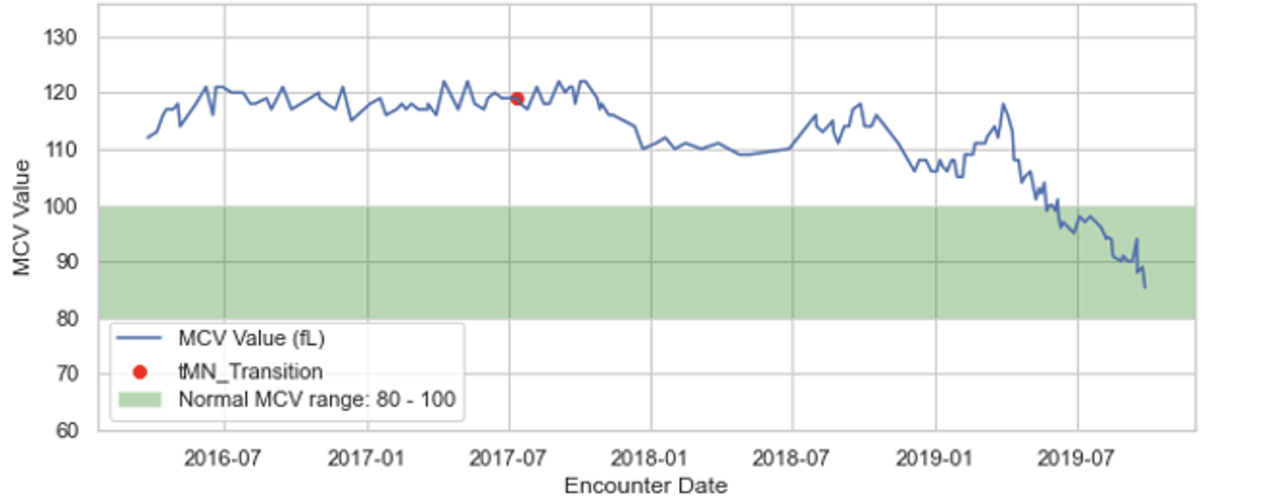
MCV – Individual Graphs
All graph titles and identifiers have been removed to protect patient privacy
20

Slide 21
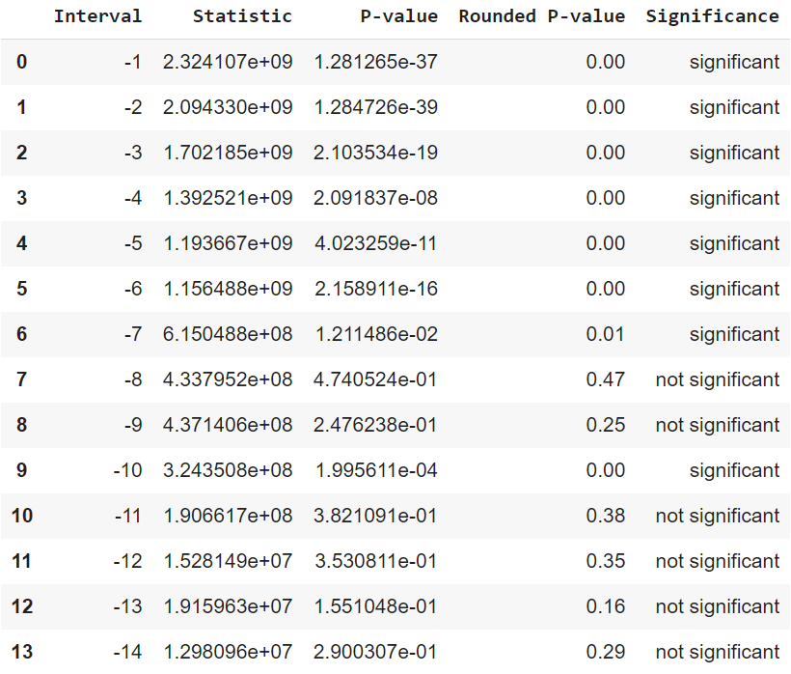
RDW-CV

Slide 22
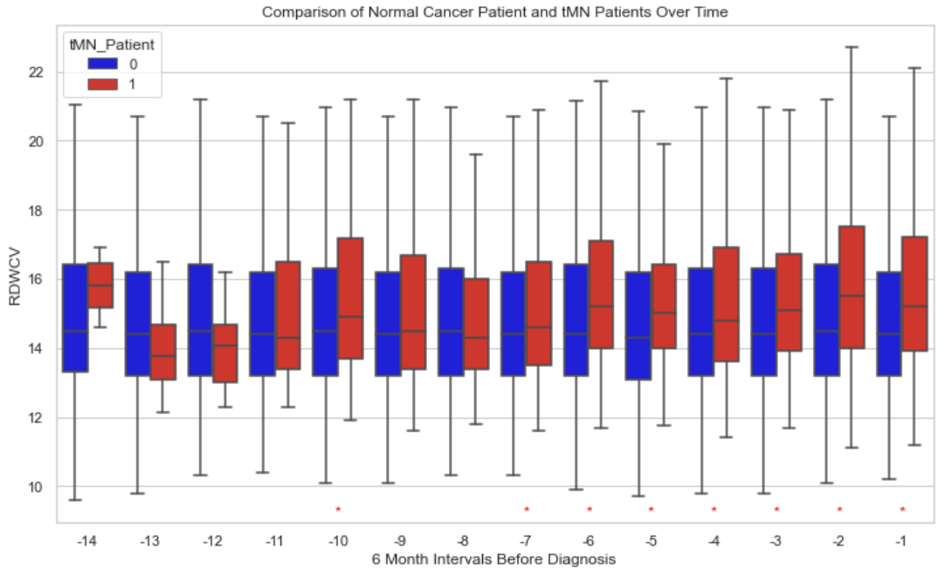
RDW-CV General Trend
tMN patients:
RDW-CV level is higher and consistently increasing dated back to 3.5 years ago
Fluctuate at interval -11
Outliers affect the group -11

Slide 23
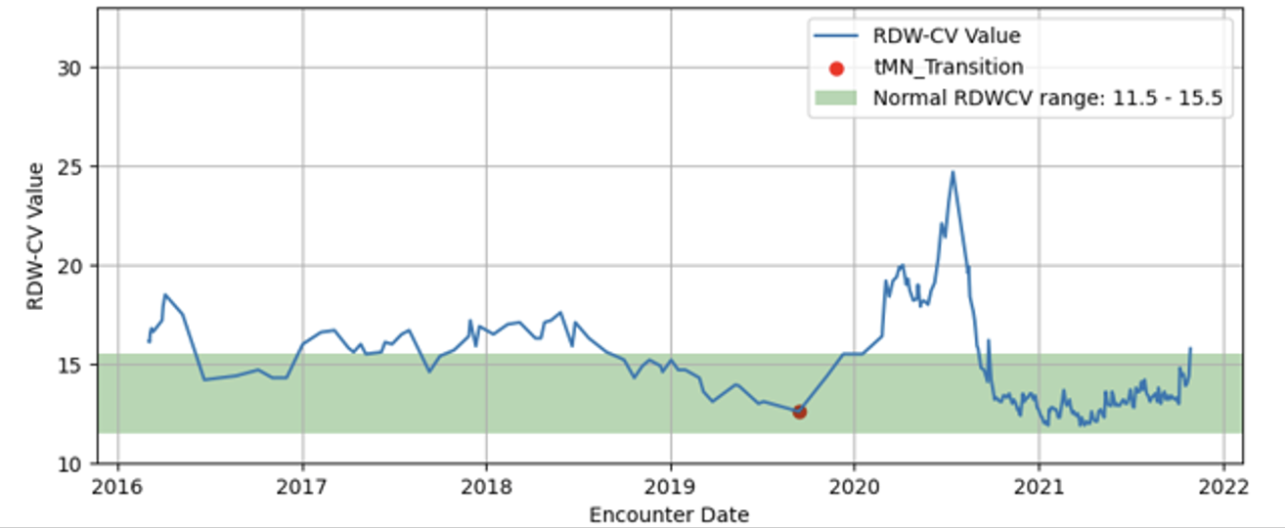
RDW-CV – Individual Graphs
All graph titles and identifiers have been removed to protect patient privacy
23

Slide 24
RDW-CV Individual Graphs – All Patients
GIF have been removed to protect patient privacy

Slide 25
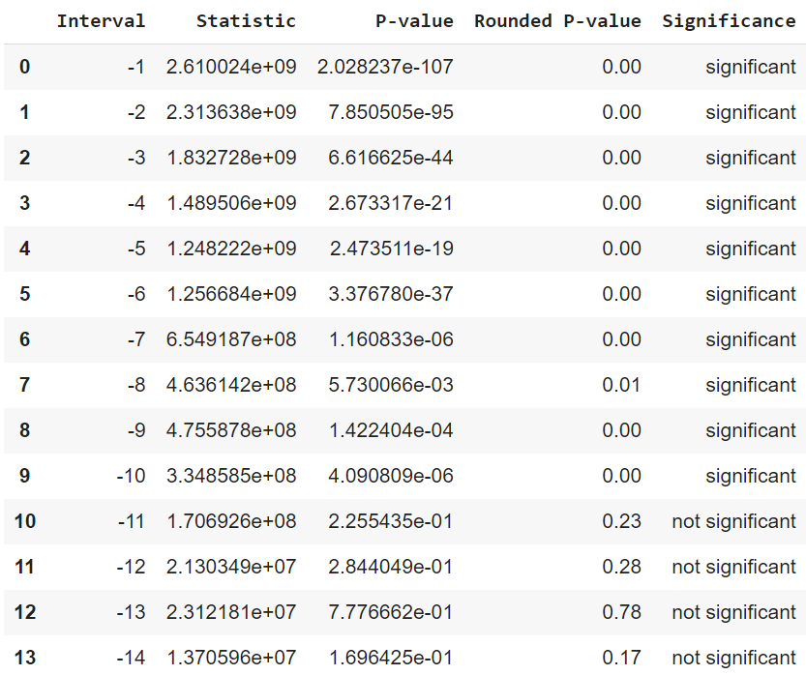
RDW-SD

Slide 26
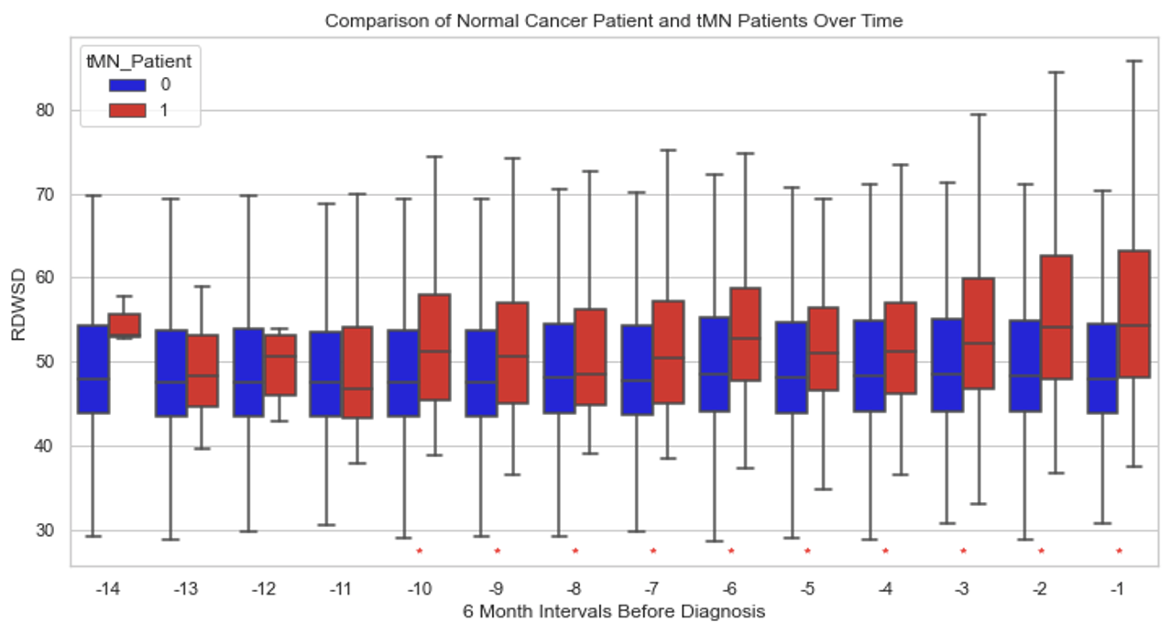
RDW-SD* General Trend
tMN patients:
RDW-SD level is higher and consistently increasing dated back to 5 years ago
Fluctuate at interval -11

Slide 27
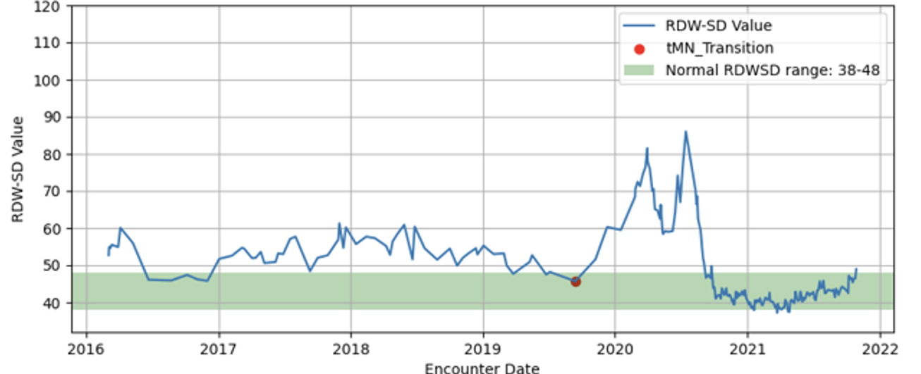
RDW-SD – Individual Graphs (Samples)
All graph titles and identifiers have been removed to protect patient privacy
27

Slide 28
RDW-SD Individual Graphs – All Patients
GIF deleted for patient privacy protection

Slide 29
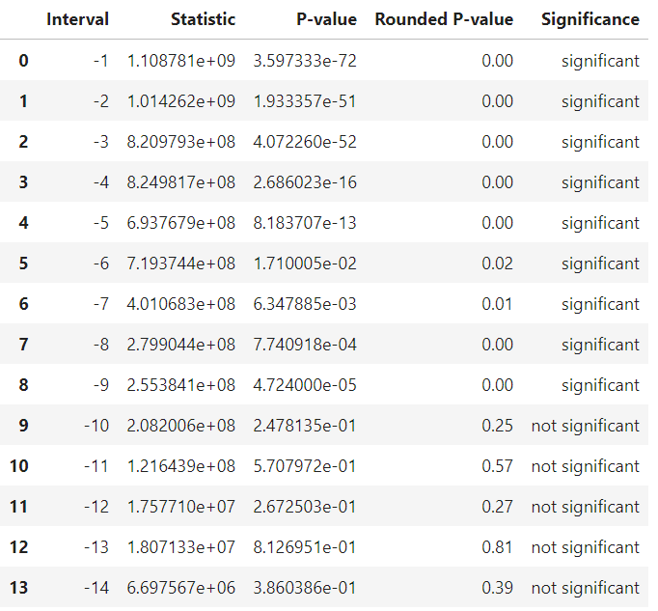
HGB

Slide 30
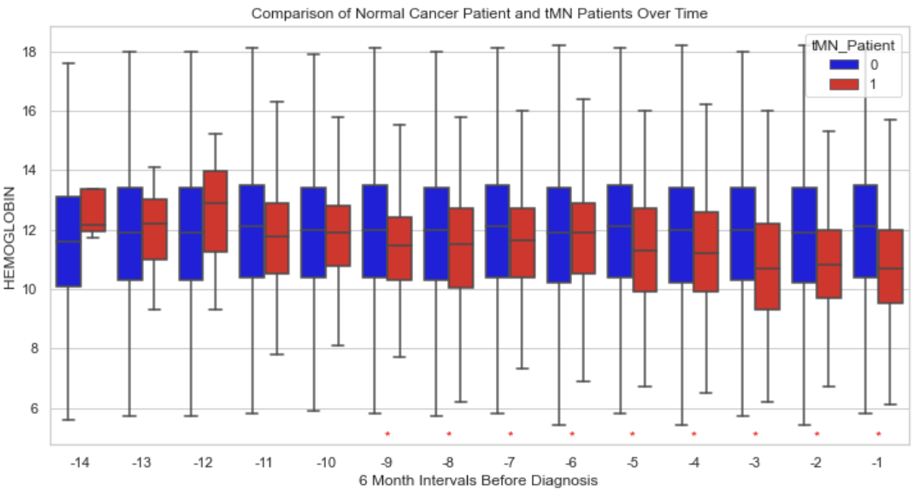
HGB – General Trend
tMN patients:
HGB level is lower and consistently decreasing dated back to 4.5 years ago
Slightly fluctuates at -6 time interval

Slide 31
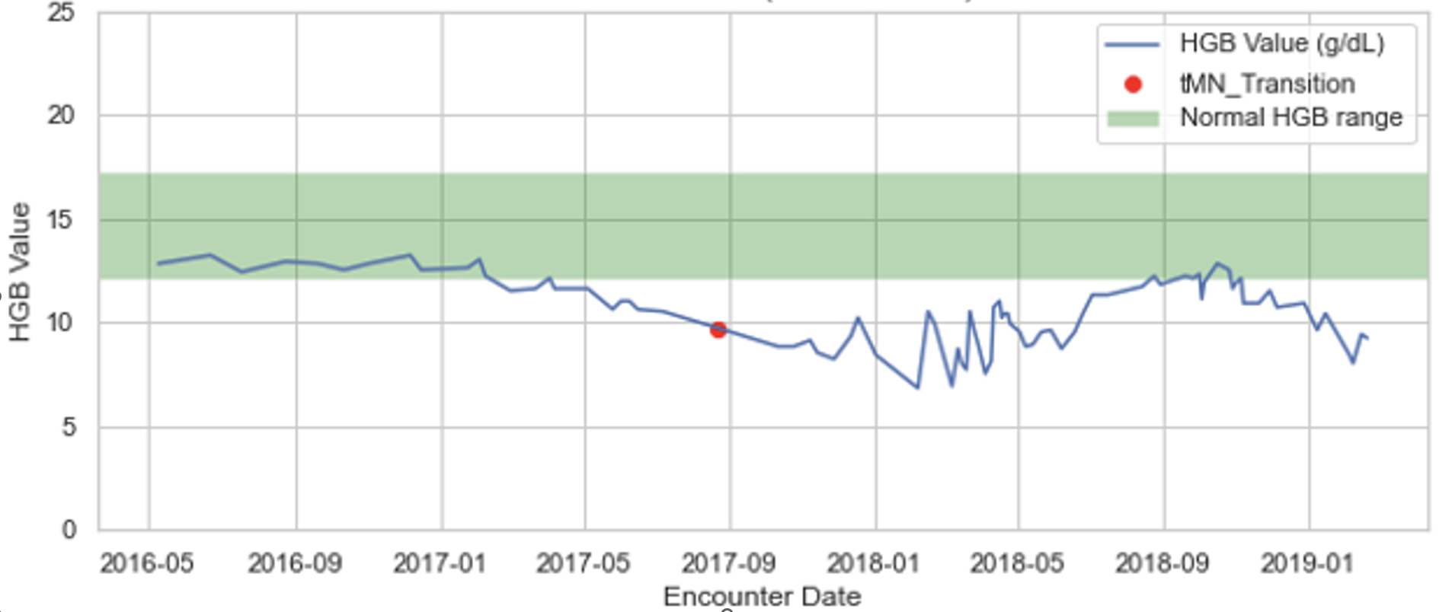
HGB – Individual Graphs
All graph titles and identifiers have been removed to protect patient privacy
31

Slide 34
11.13

Slide 35
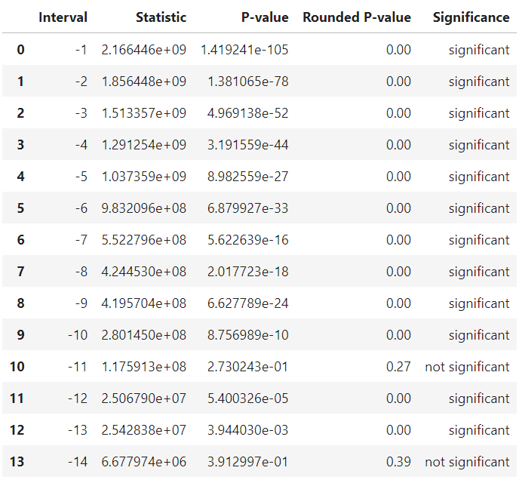
MCH

Slide 36
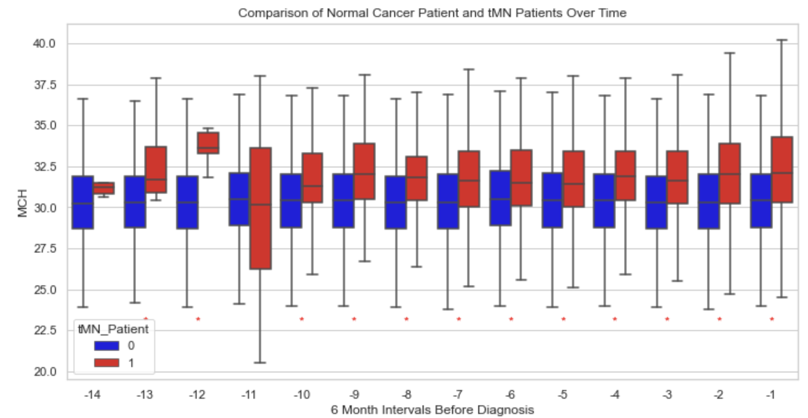
MCH – General Trend
tMN patients:
MCH level is higher and consistently increasing dated back to 5 years ago
Fluctuates at -11 time interval, needs potential cut-off
The p-value significant result also fits in the graph, for example, the -11 interval has so many value spread out below.

Slide 37
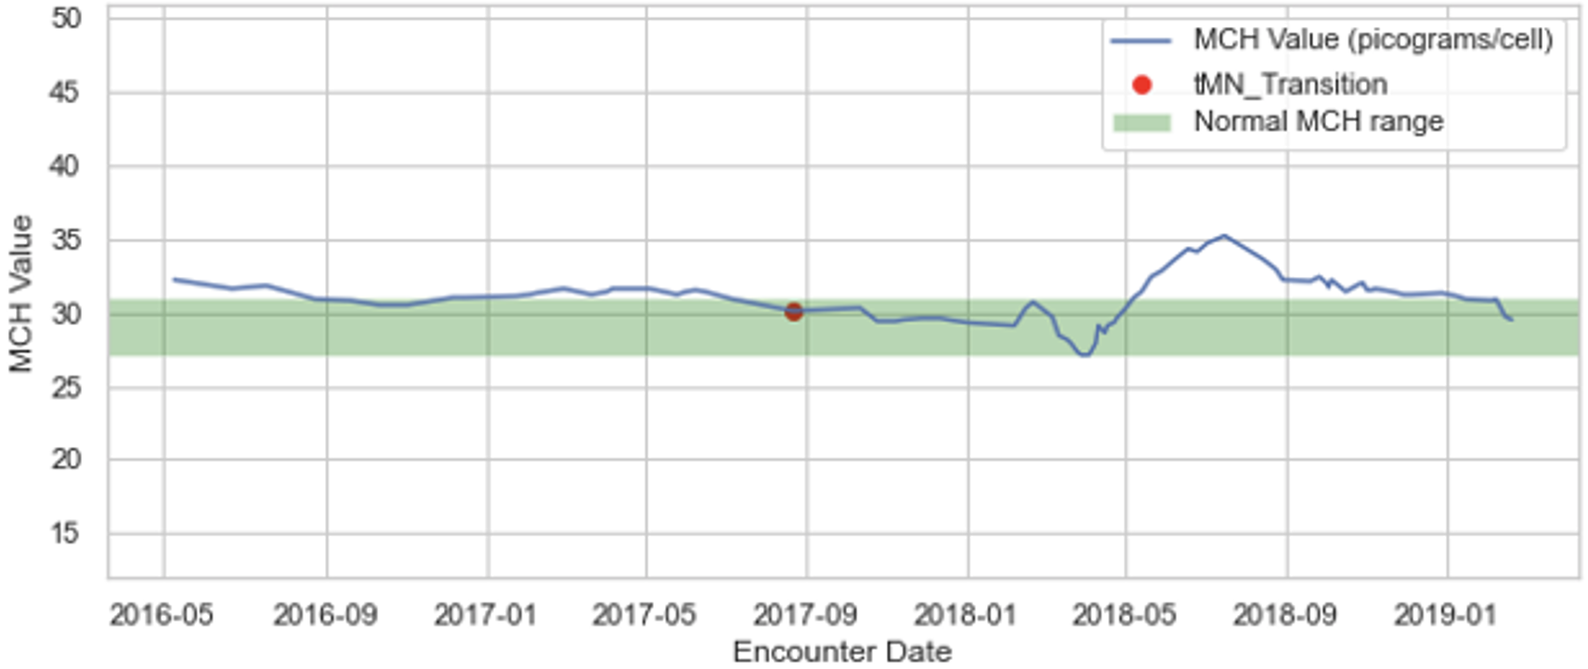
MCH – Individual Graphs
All graph titles and identifiers have been removed to protect patient privacy
37

Slide 38
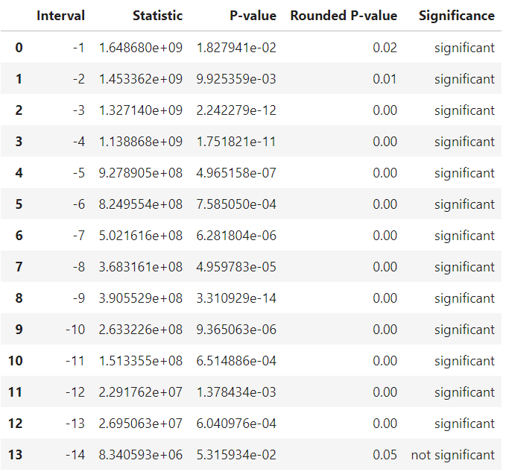
MCHC

Slide 39
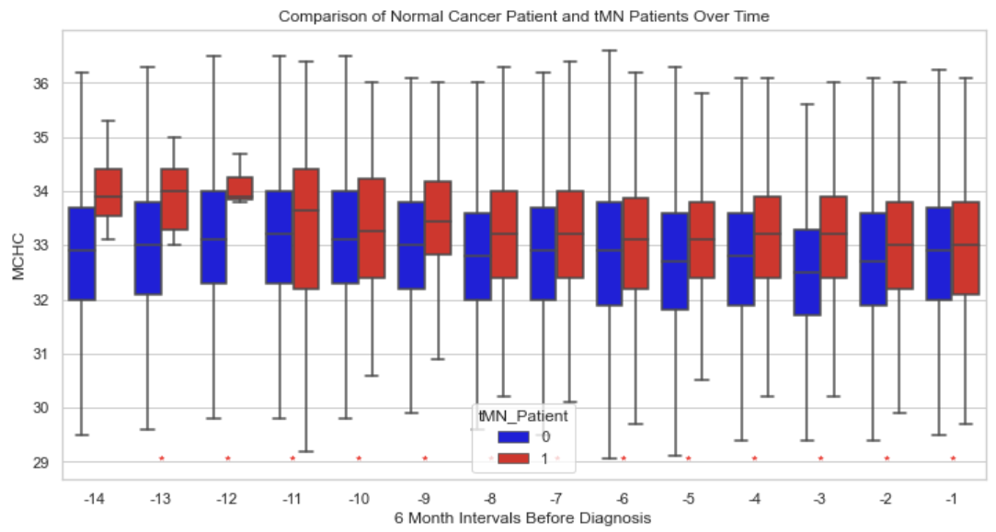
MCHC* – General Trend
tMN patients:
MCHC level is higher and consistently increasing dated back to 5.5 years ago
No significant variations

Slide 40
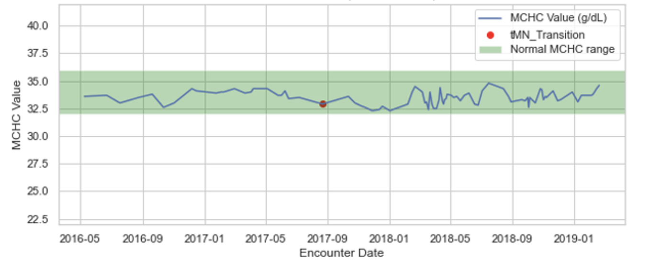
MCHC – Individual Graphs
All graph titles and identifiers have been removed to protect patient privacy
40

Slide 41
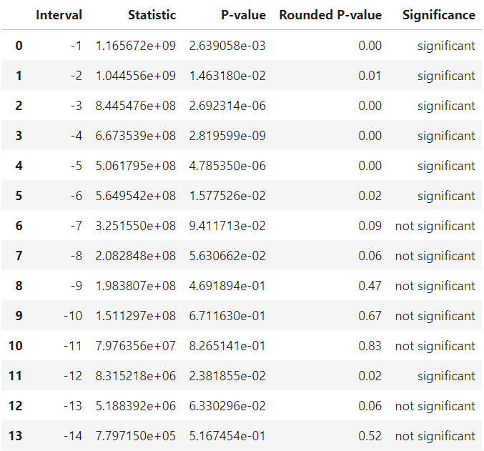
NEUTROPHIL %

Slide 42
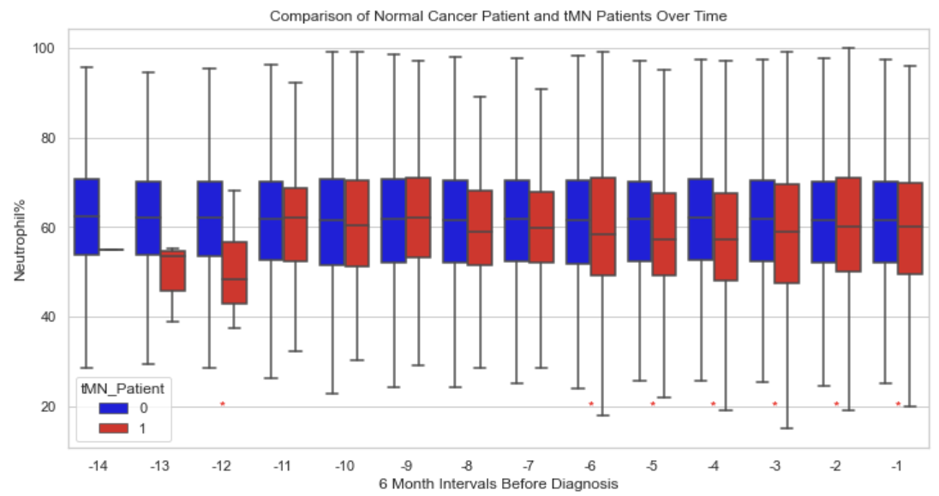
NEUT% – General Trend
tMN patients:
NEUT% level is lower and consistently decreasing dated back to 3 years ago
Fluctuate at the -11 and the -9 time interval

Slide 43
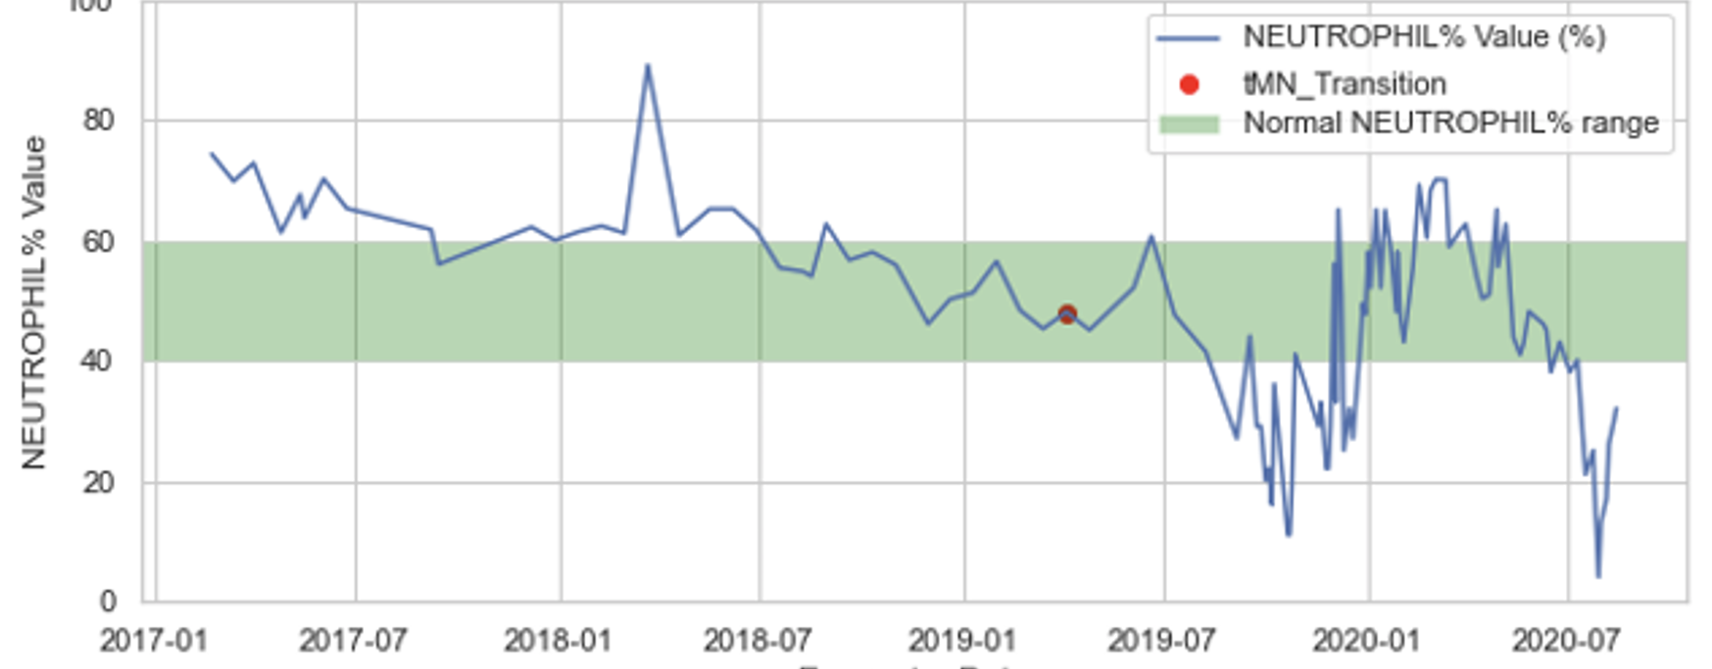
NEUT% – Individual Graphs
All graph titles and identifiers have been removed to protect patient privacy
43

Slide 44
NEUTROPHIL ABS

Slide 45
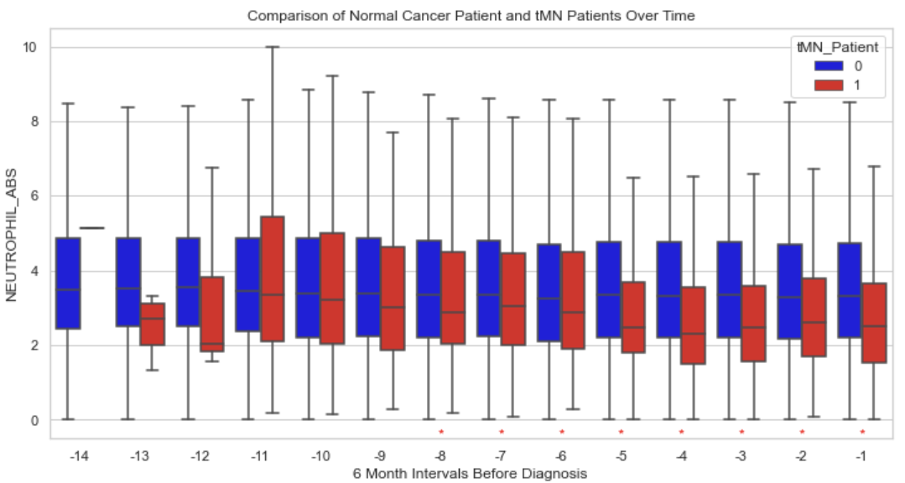
NEUT ABS – General Trend
tMN patients:
NEUT ABS level is lower and consistently decreasing
Significant differences dated back to 4 years ago

Slide 46
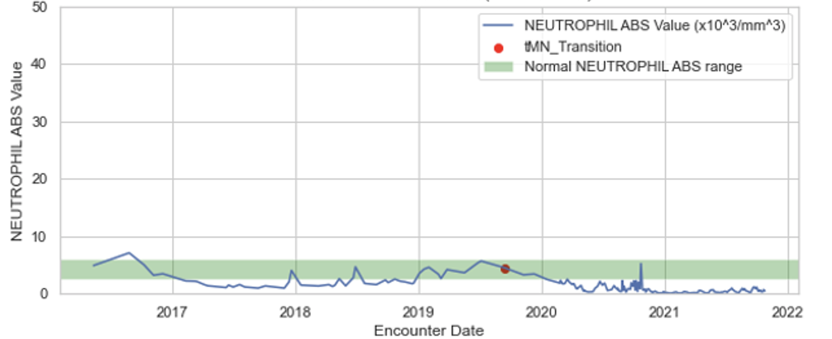
NEUT ABS – Individual Graphs
All graph titles and identifiers have been removed to protect patient privacy
46

Slide 47
PERCENT perform better than ABS
CUT-off to train more accurately

Slide 48


Slide 53
WBC
tMN patients:
RBC level is lower and consistently decreasing dated back to 3 years ago.
Outliers exist in the -14 time interval, 7 years ago
For time interval -14, significant but in the wrong direction

Slide 54
Fluctuations in p-values and changes in the results of statistical tests
1. Sample Size: The size of your change group and control group may vary across different time intervals. Smaller sample sizes can lead to more fluctuation in the results and make it harder to detect statistically significant differences.
2. Data Distribution: The distribution of your data within the change and control groups can affect the results. If the data is not normally distributed or has outliers, it can influence the significance of the test.
3. Variability: Natural variability in data can also lead to fluctuations in p-values. Some time intervals may exhibit larger variability in the data, making it challenging to identify significant differences.
4. Effect Size: Even if a difference is statistically significant, the effect size might not always be practically significant. A significant difference in means or medians might be very small in real-world terms.
5. Changes in the Control Group: Variations in the control group's characteristics or underlying data could influence the comparisons. If the control group changes over time, it can impact the results.
6. Other Variables: There may be uncontrolled or unmeasured variables that influence the results. These variables can change over time and contribute to fluctuations in significance.
Interpreting fluctuations in p-values can be complex. It's important to consider both statistical significance and practical significance. In some cases, the differences may be statistically significant but not practically significant or vice versa. If the p-value is significant, but the effect size is small or the data distribution is questionable, you should interpret the results with caution.
Additionally, the box plot variations might be due to the distribution of data. Even if the medians appear different, the distribution of values within the box plot can vary. The box plot provides a visual representation of the data's central tendency and spread, which can be valuable for understanding these fluctuations.
To gain a deeper understanding, consider looking at the full distributions, effect sizes, and the context of the data.

Slide 55
WBC
tMN patients:
RBC level is lower and consistently decreasing dated back to 3 years ago.
Highly skewed in the -14 time interval, 7 years ago
For time interval -14, significant but in the wrong direction

Slide 56
WBC
Fluctuates in significance
Sample Size not the same in each time interval group
Data Distribution
Uncontrolled or unmeasured variables

